Slide 1

TABLETOP SCENARIO EXERCISE
https://github.com/NextGenCyberEd/WeTeach_Cyber_Fall2026
https://www.blackhillsinfosec.com/tools/backdoorsandbreaches/classic
/ / WETEACH_CYBER FALL IN-PERSON MEETING
John Owen, Executive Director
nextgencybered.org
Texas Advanced Computing Center | October 19, 2026
Notes:
Welcome everyone. Quick intro on who we are, then we jump into the scenario. About 10 minutes of slides, then the rest of the hour is the exercise.

Slide 2

NEXT GEN CYBER ED
/ / WHO WE ARE
A Texas 501(c)(3) nonprofit strengthening K-12 cybersecurity education.
Our mission: connect educators and students with trusted resources, hands-on experiences, and industry partnerships.
01
02
03
Classroom support
Student empowerment
Industry connections
Vetted curriculum connections, professional development, and hands-on activities like today’s
Tabletop exercises, mock interviews with industry professionals, and mentorship
Mentors, internships, and practitioners in classrooms
// 02 OF 07
Notes:
We sit between education and industry. Three areas: supporting teachers, empowering students, and building industry connections.

Slide 3

JOHN OWEN
/ / ABOUT ME
Executive Director, Next Gen Cyber Ed
15+ years in cybersecurity and data analytics
Background in digital forensics and mathematics
Director of Security & Data Analytics, Fulcrum Technology Solutions: security operations and detection engineering
Started NGCE to narrow the gap between cybersecurity education and industry
Part-time rally driver
// 03 OF 07
Notes:
Day job in security operations and detection engineering. Started NGCE to narrow the gap between what students learn and what industry needs. And yes, that is me rally driving.

Slide 4

BUILT FOR K-12 CLASSROOMS
Realistic cyber incident scenarios written for students, organized by grade band
Players step into a role, work through an unfolding situation, and make decisions as it develops
Students join from any web browser. No installs, no lab setup.
Built around discussion, judgment, and teamwork, not just technical skill
Facilitator kits included: learning objectives, key reasoning points, and debrief questions
Request access for your school or district
nextgencybered.org/praxis-early-access
// 04 OF 07
Notes:
Praxis is our tabletop exercise platform for K-12. Browser only, nothing to install. Every scenario ships with a facilitator kit. The link is here now and again at the end.

Slide 5
HER VOICE, NOT HER WORDS
/ / TODAY’S EXERCISE
HOW IT WORKS
01
Play individually on your own device
02
The situation unfolds in stages
03
Each stage ends in a vote
[ GRADE BAND :: 10-12 ]
04
Talk it through with colleagues while voting
05
No perfect answers, only tradeoffs
YOUR ROLE
Campus Educator, Cedar Bluff High
Fictional Cedar Bluff ISD, Texas
Notice the role. Today Praxis casts you as an educator. The same platform puts students into whatever role a scenario calls for.
Something is spreading through your students’ group chats. How you respond is up to you.
// 05 OF 07
Notes:
Keep it vague on purpose: let them discover the story as it unfolds. Emphasize that they play individually but should talk with neighbors during votes. Point out the educator role as a demonstration of how flexible the platform is.

Slide 6
BEFORE WE START
/ / GROUND RULES
01
02
Decide with the information you have. You won’t have all of it.
Stay in the scenario. Treat it as real.
03
Use the voting periods. Your neighbors may see something you missed.
04
Classroom questions? Hold them for the debrief.
LET’S GO.
AT 2:00
SWOT debrief on the exercise and how it would work with your students
// 06 OF 07
Notes:
No note-taking needed. We will do a SWOT together at 2:00. Get everyone joined, then start.

Slide 7

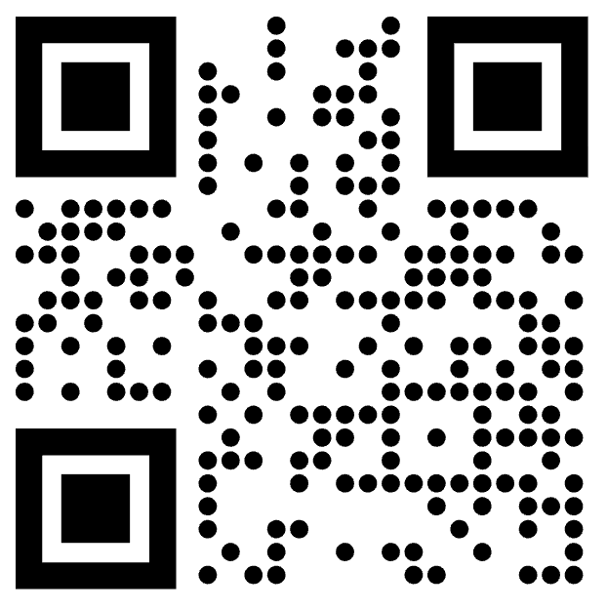
REQUEST ACCESS
/ / BRING PRAXIS TO YOUR SCHOOL
Register your school or district for access to Praxis scenarios and facilitator kits.
nextgencybered.org/praxis-early-access
John Owen | info@NextGenCyberEd.org
Notes:
Close here. Invite them to register their school or district. Leave this up during the SWOT if you want the link visible.

